Slide 1
AutoCad 2021
د. وميض تركي محمد

Slide 2
في نهاية هذا الدرس يستطيع الطالب أن يتعرف على:
استخدام المجموعة الثالثة من ادوات الرسم Use the 2nd group of drawing tools
تعيين حدود الرسم Drawing Limits
إختيار سمك خط الرسم Line Weight

Slide 3
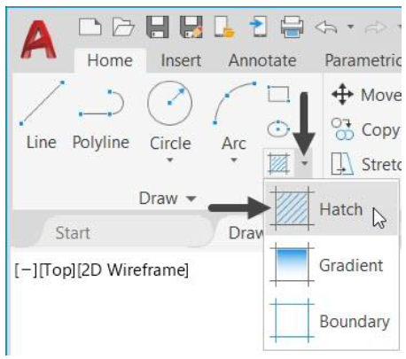
أدوات الرسم Drawing tools
The Hatch tool : The Hatch tool is used to generate hatch lines by clicking inside a closed area. When you click inside a closed area, a temporary closed boundary will be created using the PLINE command. The closed boundary will be filled with hatch lines, and then it will be deleted.

Slide 4
أدوات الرسم Drawing tools
Drawing gradient :Used to apply gradient to a closed area

Slide 5
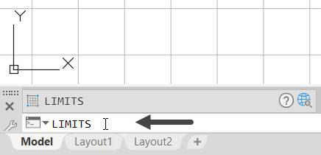
حدود مساحة الرسم Drawing limits
Setting the Limits of a drawing: You can set the limits of a drawing by specifying its lower-left and top-right corners. By setting Limits of a drawing, you will define the size of the drawing area. In AutoCAD, limits are set to some default values. However, you can redefine the limits to change the drawing area as per your requirement.
Type Limits at the command line and press ENTER
Press ENTER to accept the lower limit as 0,0.
Now, you need to specify the upper limit
Type 80,50 and press ENTER key.
• Click View > Navigate 2D > Zoom drop-down > All on the ribbon; the drawing window will be zoomed to the limits.
• Click Zoom > Zoom All from the Navigation Bar; the drawing window will be zoomed to the limits.

Slide 6
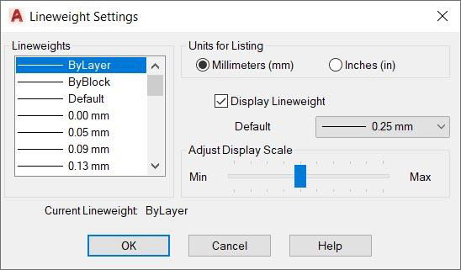
سمك خط الرسم Line weight
Setting the Line weight : Lineweight is the thickness of the objects that you draw. In AutoCAD, there is a default lineweight /thickness assigned to objects. However, you can set a new lineweight.
2
3
1

Slide 7
سمك خط الرسم Line weight
Setting the Line weight : Lineweight is the thickness of the objects that you draw. In AutoCAD, there is a default lineweight /thickness assigned to objects. However, you can set a new lineweight.
1
3
2

Slide 8
الدرس القادم ... AutoCAD 2021
في الدرس القادم ... سنبدأ بأدوات التعديل... بإذن الله
شكراً جزيلا

